Slide 1
Kubernetes Bootcamp
Containers 101

Slide 2
Kubernetes Bootcamp Agenda
1
How to create a container
2
docker compose
Notes:
For ESI customers, the TPM/iTPM must be consulted & provide approval before CSC is implemented. Be sure to always align with TPMs/iTPMs if you are considering running a challenge with ESI customers.
Andrea Waugh Metzger: LOVE Skills Challenge! I had a 60% conversion rate for ACAs last year when I ran challenges

Slide 3
But first… Let’s do a Quiz!
Notes:
Menti

Slide 4
How to create a container
Notes:
Menti

Slide 5
Building Images
Docker Build and Dockerfiles
Method for automated container image build
Consumed when running “docker build”
Caches unchanged commands
Integrates into Docker Hub or Azure Container Registry

Slide 6
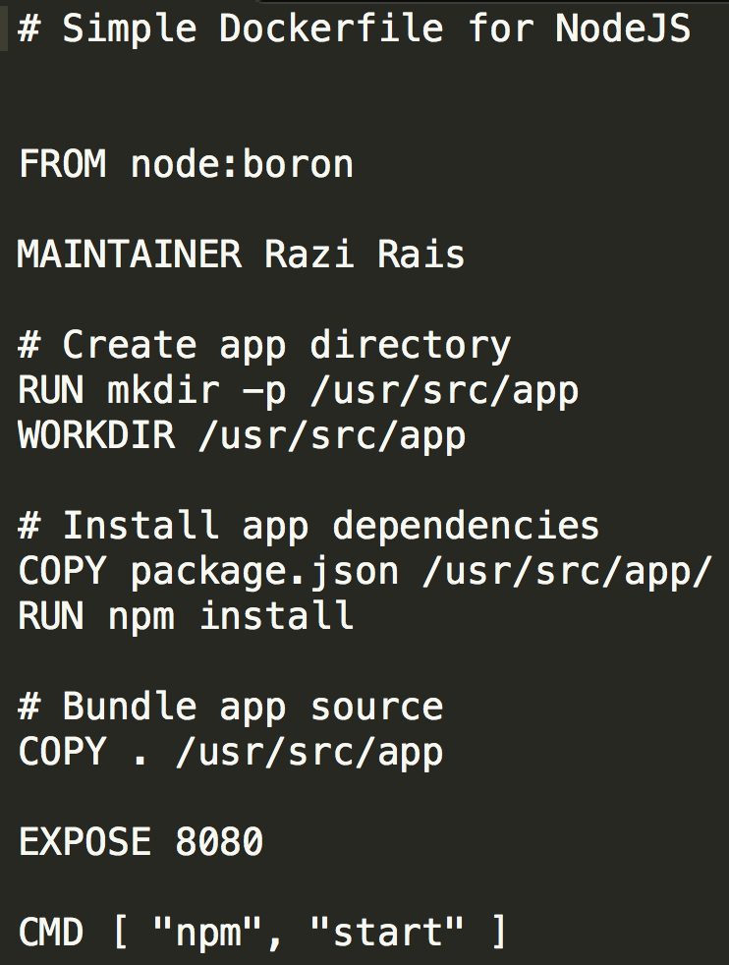
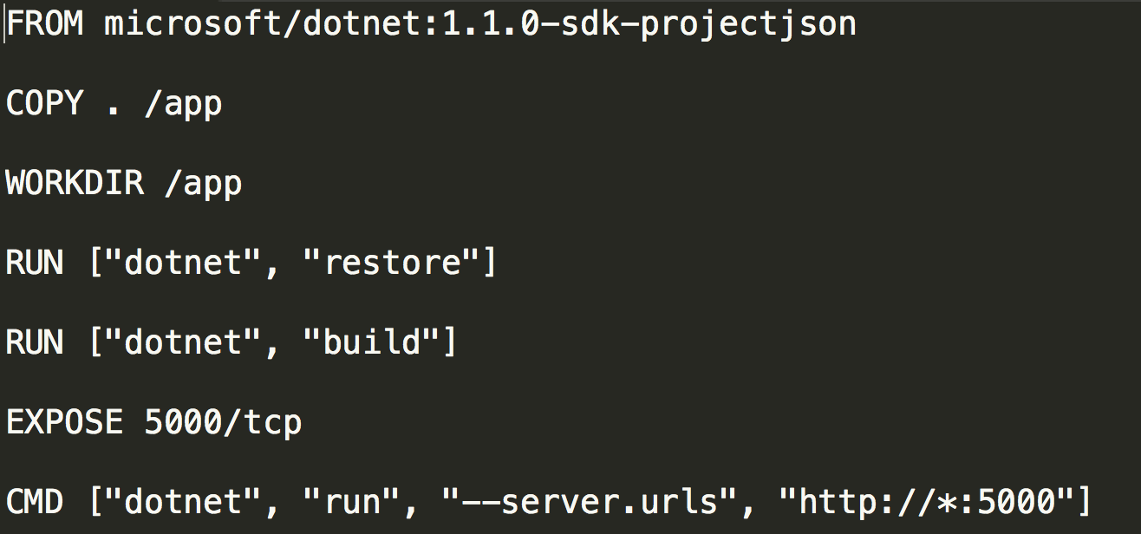
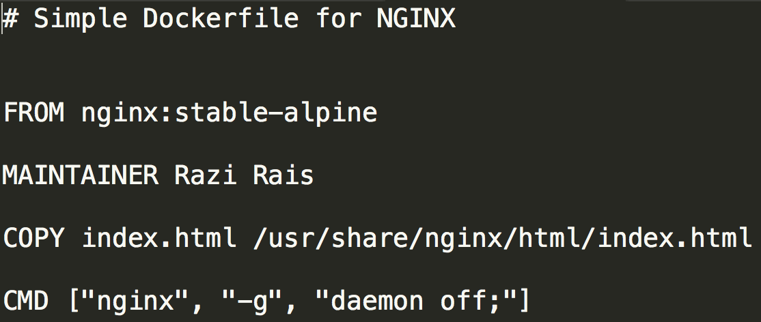
Dockerfile
Text file with Docker commands in it to create a new image. You can think of it as a configuration file with set of instructions needed to assemble a new image.
Docker has a docker build command that parses Dockerfile to build a new container image.

Slide 7
Dockerfile
ADD instruction copies new files, directories or remote file URLs from <src> and adds them to the filesystem of the image at the path <dest>.
COPY instruction copies new files or directories from <src> and adds them to the filesystem of the container at the path <dest>.
CMD provide defaults for an executing container. These defaults can include an executable.
ENTRYPOINT allows you to configure a container that will run as an executable.
EXPOSE instruction informs Docker that the container listens on the specified network port(s).
FROM instruction initializes a new build stage and sets the Base Image for subsequent instructions.
LABEL is a key-value pair, stored as a string. You can specify multiple labels for an object, but each key-value pair must be unique within an object.
RUN will execute any commands in a new layer on top of the current image and commit the results.
WORKDIR instruction sets the working directory for any RUN, CMD, ENTRYPOINT, COPY and ADD instructions that follow it.

Slide 8
Multistage dockerfile
Allow to define different stages on dockerfile
More independency from the machine where running the build command
All steps are performed inside containers
Uses heavy containers to do compilation and cleaner and lighter containers to execute application
Allows to create partial build commands

Slide 9
Demo

Slide 10
Docker compose
Notes:
Menti

Slide 11
Docker compose
Compose is a tool for defining and running multi-container Docker applications
Single compose file defined in .yml/.yaml format defines your application services
Good for development environments, automated testing environments and single host deployments

Slide 12
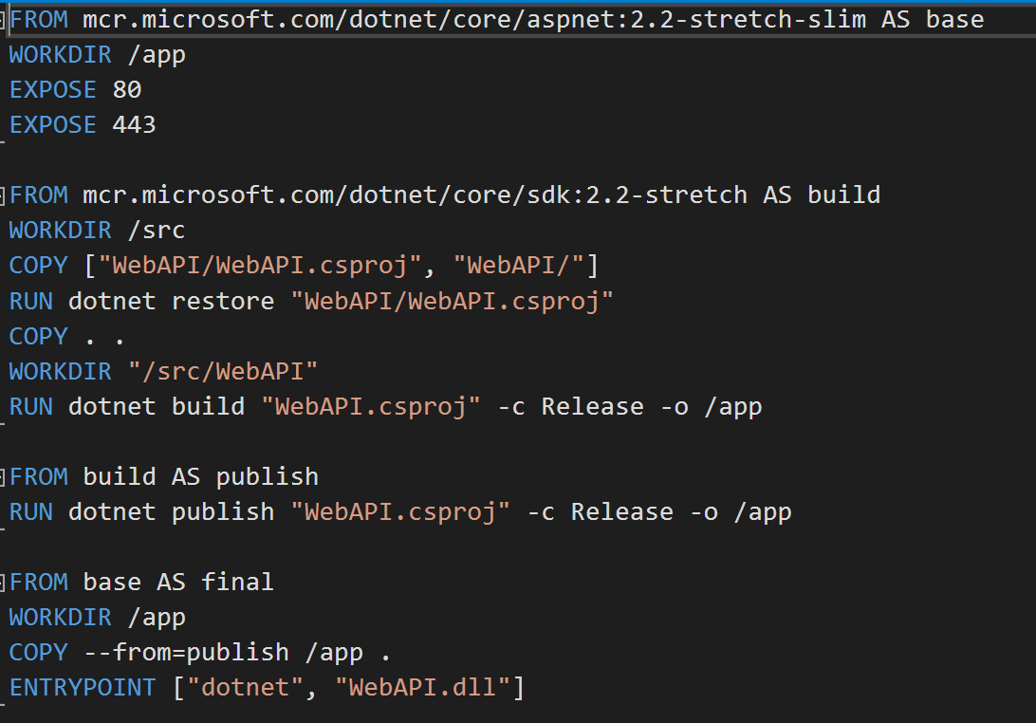
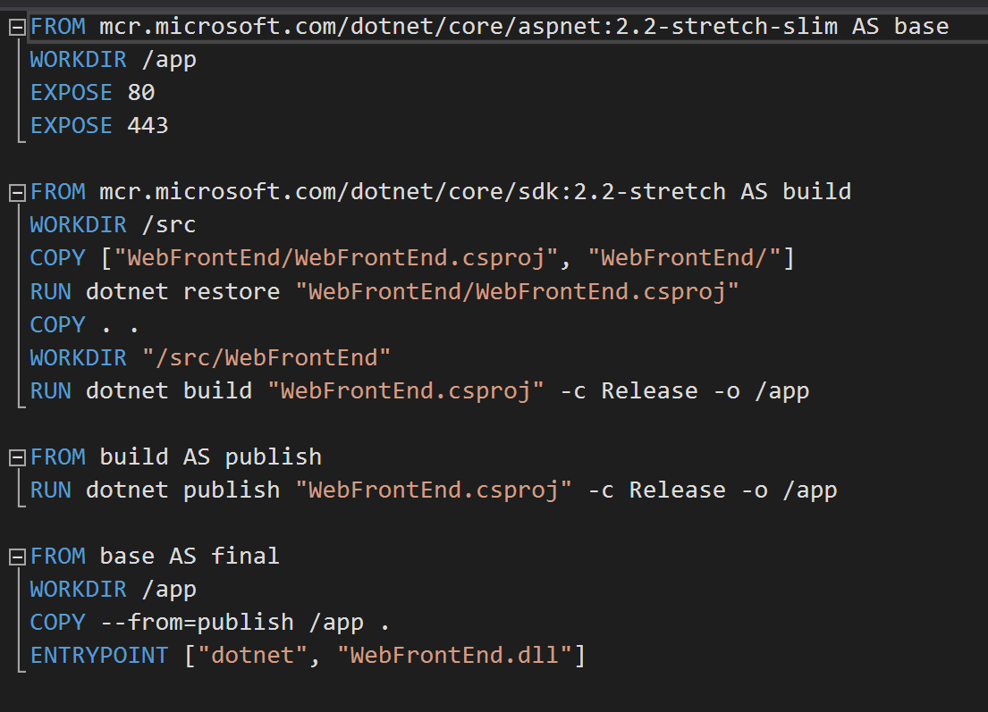
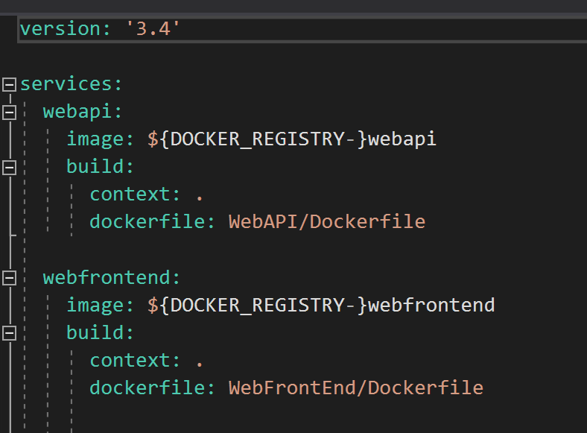
Docker compose
Define your app’s environment with a Dockerfile so it can be reproduced anywhere
Define the services that make up your app in docker-compose.yml so they can be run together in an isolated environment
Run docker-compose up and Compose will start and run your entire app
Dockerfile | webapi
Dockerfile | webapp
Docker-Compose.yaml

Slide 13
Demo

Slide 14
Lab
Build a containerized web application with Docker - Learn | Microsoft Docs

